Slide 1
MAINTENANCE OF CAMERA CALIBRATION
The maintenance of the camera calibration is supposed to be simple
The camera position doesn’t change during the season, so there’s no need to start from scratch

Slide 2
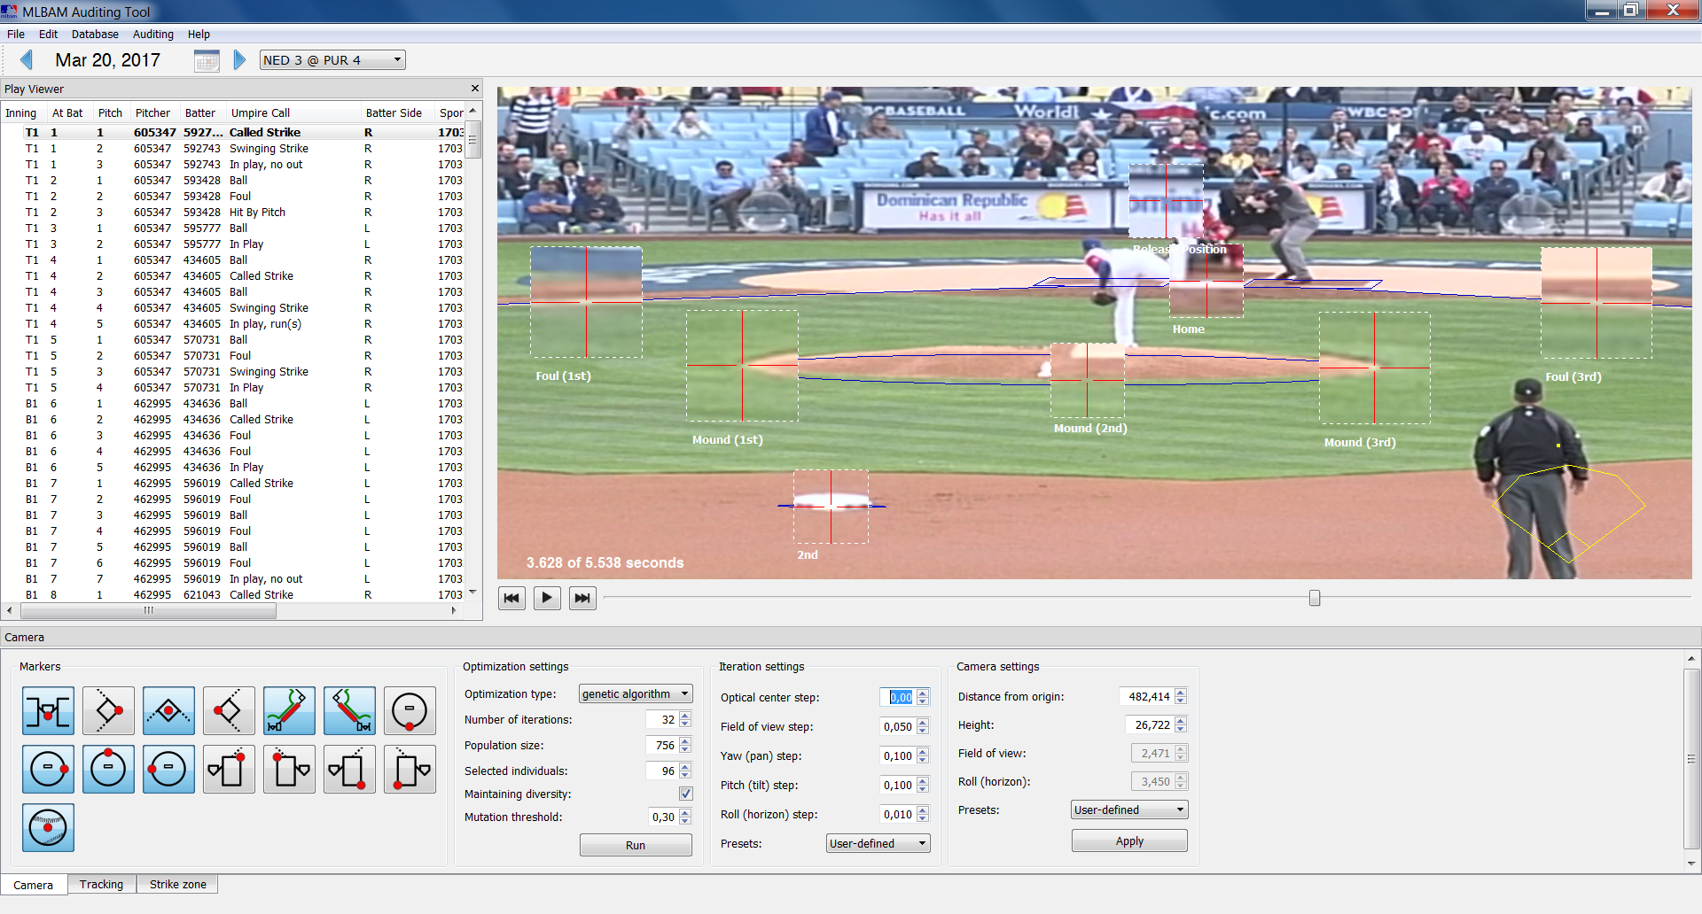
MAINTENANCE OF CAMERA CALIBRATION
Select the first pitch
Select the “Camera” tab

Slide 3
MAINTENANCE OF CAMERA CALIBRATION
On the “Operation settings” box
Set the “Number of iterations” spin box to 64

Slide 4
MAINTENANCE OF CAMERA CALIBRATION
On the “Iteration settings” box
Set the “Presets” combo to “User-defined”
Set the “Optical center step” to 0 (zero)

Slide 5
MAINTENANCE OF CAMERA CALIBRATION
Markers
Move the “Foul (1st)” marker to the top of the foul line

Slide 6
MAINTENANCE OF CAMERA CALIBRATION
Markers
Move the “Foul (3rd)” marker to the top of the foul line

Slide 7
MAINTENANCE OF CAMERA CALIBRATION
Markers
Move the “Home” marker to the tip of the home plate

Slide 8
MAINTENANCE OF CAMERA CALIBRATION
Markers
Move the “2nd” marker to the center of the base (the lower part)

Slide 9
MAINTENANCE OF CAMERA CALIBRATION
Markers
Move the active pitching mound markers to the edges of the pitching mound

Slide 10
MAINTENANCE OF CAMERA CALIBRATION
Markers
Play the video until the moment the pitcher releases the ball
Set the “Release Position” marker (if active) to the ball position on the video

Slide 11
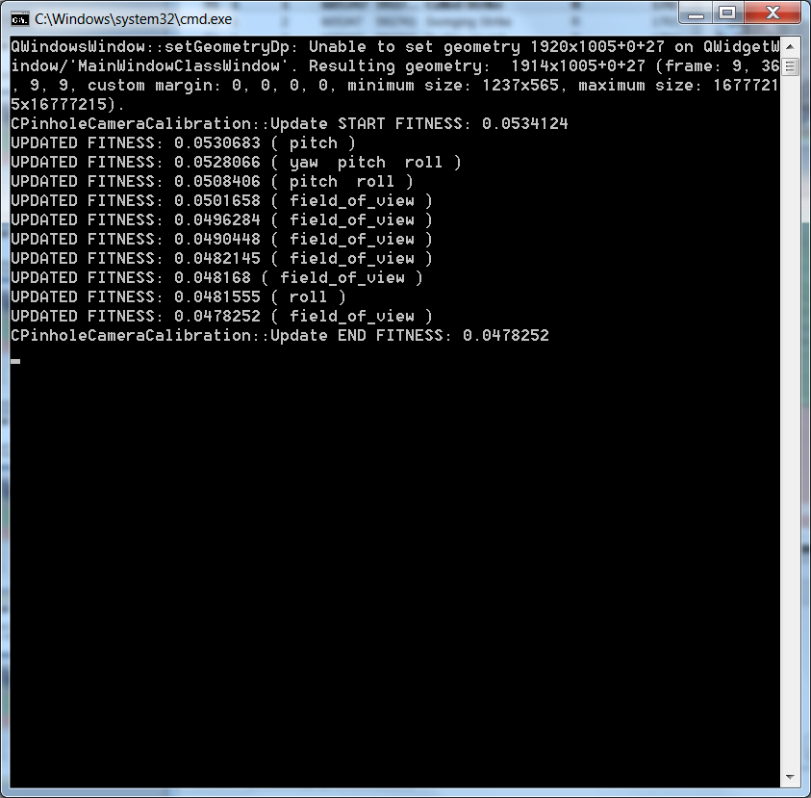
MAINTENANCE OF CAMERA CALIBRATION
Click on “Run” until the blue lines converge to the field layout
The algorithm is iterative, so it may take 4-6 clicks
The terminal screen will output updates to the calibration

Slide 12
MAINTENANCE OF CAMERA CALIBRATION
Once the blue lines are close to the field layout, go back to the “Strike zone” tab
The “Zoomed view” will not work (or will be off-center), since it depends on a stored calibration
Make sure the home plate matches the blue lines
To adjust the calibration, set the calibration to “Automatic” and use the keyboard
The calibration will be recorded when you move to the next pitch

Slide 13
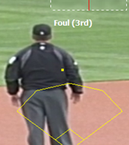
MAINTENANCE OF CAMERA CALIBRATION
Keep in mind:
The calibration should be updated in the first pitch
The yellow dot that represents the camera position should not move during the calibration
Setting the “Optical center step” to 0 (zero) makes sure the camera will not move

Slide 14
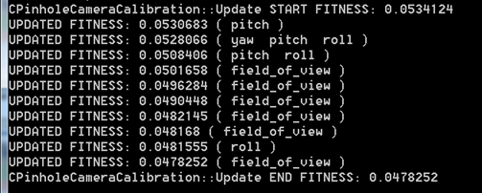
MAINTENANCE OF CAMERA CALIBRATION
Keep in mind:
You can hit the “Run” button while there are messages being printed between “START FITNESS” and “END FITNESS” on the terminal
These messages indicate changes on the calibration

Slide 15
MAINTENANCE OF CAMERA CALIBRATION
Keep in mind:
The assumption is that the tracking data is correct, so the calibration should be updated until the tracking data corresponds to the ball in the video
That said, the tracking data is not always correct

Slide 16
TROUBLESHOOTING

